Slide 1

Mathematical Functions, Characters, and Strings
TUIT
C++ Programming, Fall 2016
Lecture #4
I – part

Slide 2
TUIT
Roadmap
Last week we covered
Selections
This week we will learn
Introduction
Mathematical Functions
Case Study: Computing Angles of a Triangle
Character Data Type and Operations
Case Study: Generating Random Characters
Case Study: Guessing Birthdays

Slide 3
TUIT
Introduction
The focus of this theme is to introduce mathematical functions, characters, and string objects, and use them to develop programs.
Suppose you need to estimate the area enclosed by four cities, given the GPS locations (latitude and longitude) of these cities, as shown in the following diagram.
Tashkent (41.311081, 69.240562)
Samarkand(66.9749731, 39.627012)
Namangan(69.329524, 41.356498)
Jizzakh (40.416665, 67.666664)

Slide 4
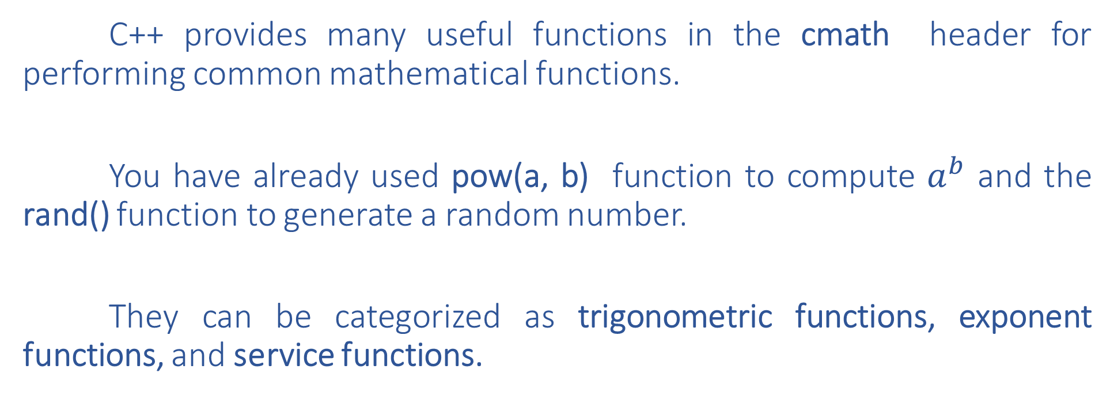
TUIT
Mathematical Functions
C++ provides many useful functions in the cmath header for performing common mathematical functions.
You have already used pow(a, b) function to compute $a^{b}$ and the rand() function to generate a random number.
They can be categorized as trigonometric functions, exponent functions, and service functions.

Slide 5
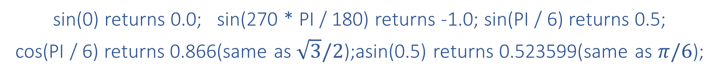
TUIT
Trigonometric Functions
C++ provides the following functions for performing trigonometric functions in the cmath header:
Function | Description
sin (radians) | Returns the trigonometric sine of an angle in radians
cos (radians) | Returns the trigonometric cosine of an angle in radians
tan (radians) | Returns the trigonometric tangent of an angle in radians
asin (a) | Returns the angle in radians for the inverse of sine
acos (a) | Returns the angle in radians for the inverse of cosine
atan (a) | Returns the angle in radians for the inverse of tangent
sin(0) returns 0.0; sin(270 * PI / 180) returns -1.0; sin(PI / 6) returns 0.5;
cos(PI / 6) returns 0.866(same as $\sqrt{3}/2$);asin(0.5) returns 0.523599(same as $π/6$);

Slide 6
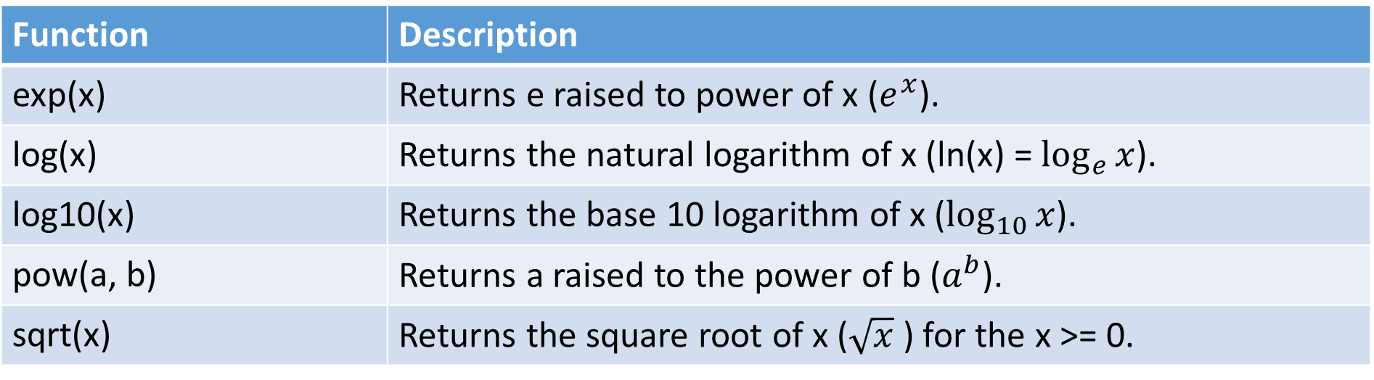
TUIT
Exponent Functions
Exponent Functions in the cmath Header
Function | Description
exp(x) | Returns e raised to power of x ($e^{x}$).
log(x) | Returns the natural logarithm of x (ln(x) = $\log_{e}{x}$).
log10(x) | Returns the base 10 logarithm of x ($\log_{10}{x}$).
pow(a, b) | Returns a raised to the power of b ($a^{b}$).
sqrt(x) | Returns the square root of x ($\sqrt{x}$ ) for the x >= 0.
exp(1.0) returns 2.71828; log(E) returns 1.0; log10(10) returns 1.0;
pow(2.0, 3) returns 8.0; sqrt(4.0) returns 2.0; sqrt(10.5) returns 3.24

Slide 7
TUIT
Rounding Functions
The cmath header contains the functions for obtaining rounding as shown this table:
Function | Description
ceil(x) | X is rounded up to its nearest integer. This integer is returned as a double value.
floor(x) | x is rounded down to its nearest integer. This integer is returned as a double value.
ceil(2.1) returns 3.0, ceil(2.0) returns 2.0, ceil(-2.0) returns -2.0, ceil(-2.1) returns -2.0;
floor(2.1) returns 2.0, floor(2.0) returns 2.0, floor(-2.0) returns -2.0, floor(-2.1) returns -3.0;

Slide 8
TUIT
The min, max, and abs Functions
The min and max functions return the minimum and maximum numbers of two numbers (int, long, float, or double). For example:
max(2, 3) returns 3
max(2.5, 3.0) returns 3.0
min(2.5, 4.6) returns 2.5
The abs function returns the absolute value of the number (int, long, float, or double).
abs(-2) returns 2
fabs(-2.1) returns 2.1
NOTE. The functions min, max, and abs are defined in the cstdlib header

Slide 9
TUIT
Case Study: Computing Angles of a Triangle
You can use the math functions to solve many computational problems. Given the three sides of a triangle, for example, you can compute the angles by using the following formula:
x2, y2
a
x3, y3
C
B
A = acos((a * a – b * b – c * c) / (-2 * b * c))
B = acos((b * b – a * a – c * c) / (-2 * a * c))
C = acos((c * c – b * b – a * a) / (-2 * a * b))
c
b
A
x1, y1

Slide 10
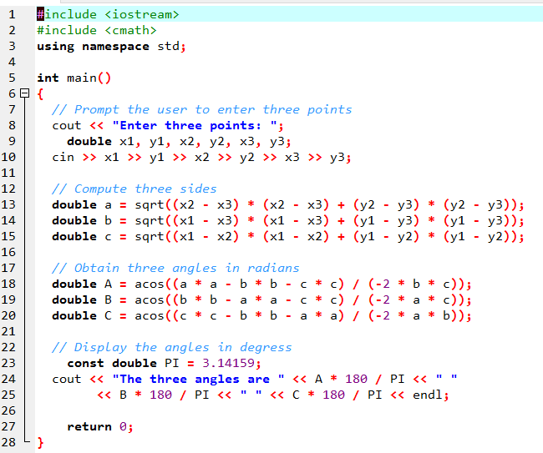


TUIT
Case Study: Computing Angles of a Triangle
Enter three points: 1 1 6.5 1 6.5 2.5 The three angles are 15.2551 90.0001 74.7449

Slide 11
TUIT
Check Point
Assume PI is 3.14159 and E is 2.71828, evaluate the following function calls:
sqrt(4.0)
sin(2 * PI)
cos(2 * PI)
pow(2.0, 2)
log(E)
exp(1.0)
max(2, min(3, 4))
sqrt(125.0)
ceil(-2.5)
(j) floor(-2.5)
(k) asin(0.5)
(l) acos(0.5)
(m) atan(1.0)
(n) ceil(2.5)
(o) floor(2.5)
(p) log10(10.0)
(q) pow(2.0, 3)

Slide 12
TUIT
Check Point
True or false? The argument for trigonometric functions is an angle in radians.
Write a statement that converts 47 degrees to radians and assigns the result to a variable.
Write a statement that converts π / 7 to an angle in degrees and assigns the result to a variable.

Slide 13
TUIT
Character Data Type and Operations
A character data type represents a single character. The character data type, char, is used to represent a single character. A character literal is enclosed in single quotation mark. Consider the following code:
char letter = ‘A’;
char numChar = ‘4’;

Slide 14
TUIT
Caution
A string literal must be enclosed in quotation marks (“ “). A character literal is a single character enclosed in single quotation marks (‘ ‘). Therefore, “A” is a string and ‘A’ is a character.

Slide 15
TUIT
ASCII(American Standard Code for Information Interchange) Code
Most computers use ASCII, an 8-bit encoding scheme for representing all uppercase and lowercase letters, digits, punctuation marks, and control characters. On most systems, the size of the char type is 1 byte.
Function | Description
‘0’ to ‘9’ | 48 to 57
‘A’ to ‘Z’ | 65 to 90
‘a’ to ‘z’ | 97 to 122

Slide 16
TUIT
Note
The increment and decrement operators can also be used on char variables to get the next or preceding ASCII code character. For example, the following statements display character b.
char ch = ‘a’;
cout << ++ch;

Slide 17
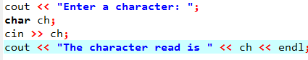
TUIT
Reading a Character from the Keyboard
To read a character from the keyboard, use:

Slide 18
TUIT
Escape Sequences for Special Characters
Suppose you want to print a message with quotation marks in the output. Can you write a statement like this?
cout << “He said Programming is fun”” << endl;
No, this statement has a compile error.
Escape Sequence | Name | ASCII Code
\b | Backspace | 8
\t | Tab | 9
\n | Linefeed | 10
\f | Formfeed | 12
\r | Carriage Return | 13
\\ | Backslash | 92
\” | Double Qoute | 34

Slide 19
TUIT
Escape Sequences for Special Characters
So, now you can print the quoted message using the following statement:
cout << “He said \”Programming is fun\”” << endl;
The output is He said “Programming is fun”.
Note that the symbols \ and “ together represent one character. The backslash is called an escape character.

Slide 20
TUIT
Note
The characters ‘ ‘, ‘\t’, ‘\f’, ‘\r’, and ‘\n’ are known as the whitespace characters.
Both of the following statements display a string and move the cursor to the next line:
cout << “Welcome to C++\n”;
cout << “Welcome to C++” << endl;
However, using endl ensures that the output is displayed immediately on all platforms.

Slide 21
TUIT
Casting between char and Numeric Types
A char can be cast into any numeric type, and vice versa. When an integer is cast into a char, only its lower 8 bits of data are used; the other part is ignored. For example:
char c = 0XFF41; // The lower 8 bits hex code 41 is assigned to c
cout << c; // variable c is character
When a floating – point value is cast into a char, the floating point value is first cast into an int, which is then cast into a char.
char c = 65.25; // 65 is assigned to variable c
cout << c; // variable c is character A
When a char is cast into a numeric type, the character’s ASCII is cast into the specified numeric type , For example:
int i = ‘A’; // The ASCII code of character A is assigned to i
cout << i; // variable i is 65

Slide 22
TUIT
Casting between char and Numeric Types
// The ASCII code for ‘2’ is 50 and for ‘3’ is 51
int i = ‘2’ + ‘3’;
cout << “i is ” << i << endl; // i is now 101
int j = 2 + ‘a’; // The ASCII code for ‘a’ is 97
cout << “j is ” << j << endl;
cout << j << “ is the ASCII code for character ” <<
Static_cast<char>(j) << endl;
Result:
i is 101
j is 99
99 is the ASCII code for character c

Slide 23
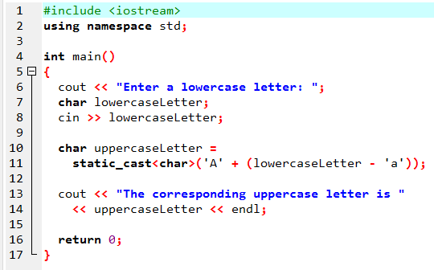
TUIT
Example ToUpperCase.cpp
Enter a lowercase letter: b The corresponding uppercase letter is B

Slide 24
TUIT
Comparing and Testing Characters
Two characters can be compared using the relational operators just like comparing two numbers. This is done by comparing the ASCII codes of the two characters. For example:
‘a’ < ‘b’ is true because the ASCII code for ‘a’ (97) is less than the ASCII code for ‘b’ (98).
‘a’ < ‘A’ is false because the ASCII code for ‘a’ (97) is greater than the ASCII code for ‘A’ (65).
‘1’ < ‘8’ is true because the ASCII code for ‘1’ (49) is less than the ASCII code for ‘8’ (56).

Slide 25
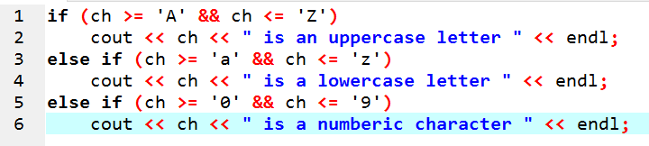
TUIT
Comparing and Testing Characters
Often you need to test whether a character is a number, a letter, an uppercase letter, or a lowercase letter. For example, the following code tests whether a character ch is an uppercase letter.

Slide 26
TUIT
Check Point
Are the following correct literals for characters?
‘1’, ‘\t’, ‘&’, ‘\b’, ‘\n’

Slide 27
TUIT
Check Point
How do you display the characters \ and “?

Slide 28
TUIT
Check Point
Show the printout of the following code:
int i = ‘1’;
int j = ‘1’ + ‘2’;
int k = ‘a’;
char c = 90;
cout << i << “ “ << j << “ ” << k << “ “ << c << endl;

Slide 29
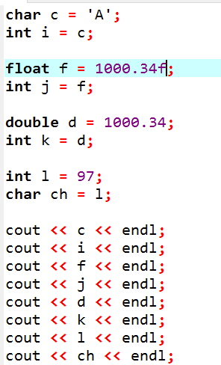
TUIT
Check Point
Show the printout of the following code:

Slide 30
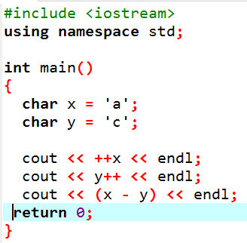
TUIT
Check Point
Show the printout of the following code:

Slide 31
TUIT
Case Study: Generating Random Characters
A character is coded using an integer. Generating a random character is to generate an integer.
rand() % 10 - Returns a random integer between 0 and 9.
50 + rand() % 50 - Returns a random integer between 50 and 99.
In general,
a + rand() % 50 - Returns a random number between a and a+b, excluding a+ b.

Slide 32
TUIT
Case Study: Generating Random Characters
Now let us consider how to generate a random lowercase letter.
static_cast<int>(‘a’)+rand()%(static_cast<int>(‘z’)-static_cast<int>(‘a’)+1)
Thus, the preceding expression can be simplified as follows:
‘a’ + rand() % (‘z’ – ‘a’ + 1)
and a random lowercase letter is
static_cast<char>(‘a’ + rand() % (‘z’ – ‘a’ + 1))

Slide 33
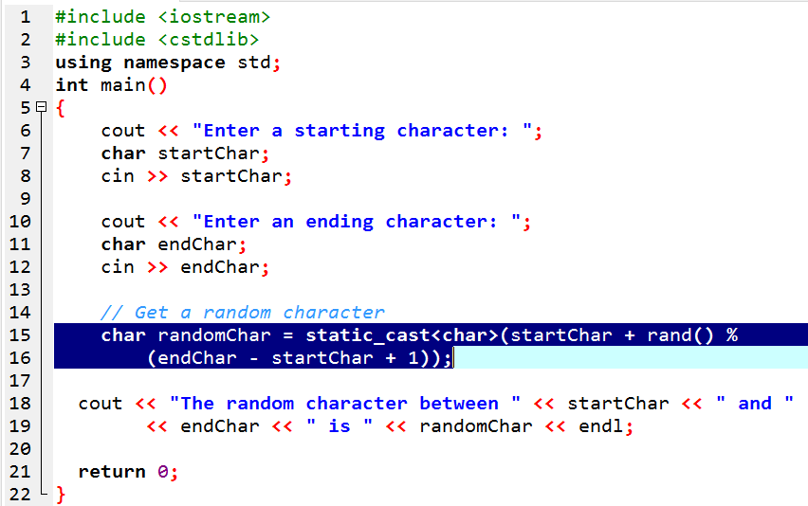
TUIT
Case Study: Generating Random Characters
Enter a starting character: a Enter an ending character: z The random character between a and z is p

Slide 34
TUIT
Case Study: Guessing Birthday
Guessing birthdays is an interesting problem with a simple programming solution.
You can determine the day of the month when your friend was born by asking five questions, Each question asks weather the day is in one of the following five sets of numbers.
= 19
+
1 3 5 7
9 11 13 15
19 21 23
25 27 29 31
3 6 7
11 14 15
19 22 23
26 27 30 31
5 6 7
13 14 15
21 22 23
28 29 30 31
9 10 11
13 14 15
25 26 27
28 29 30 31
17 18 19
21 22 23
25 26 27
28 29 30 31
Set1
Set2
Set3
Set4
Set5

Slide 35
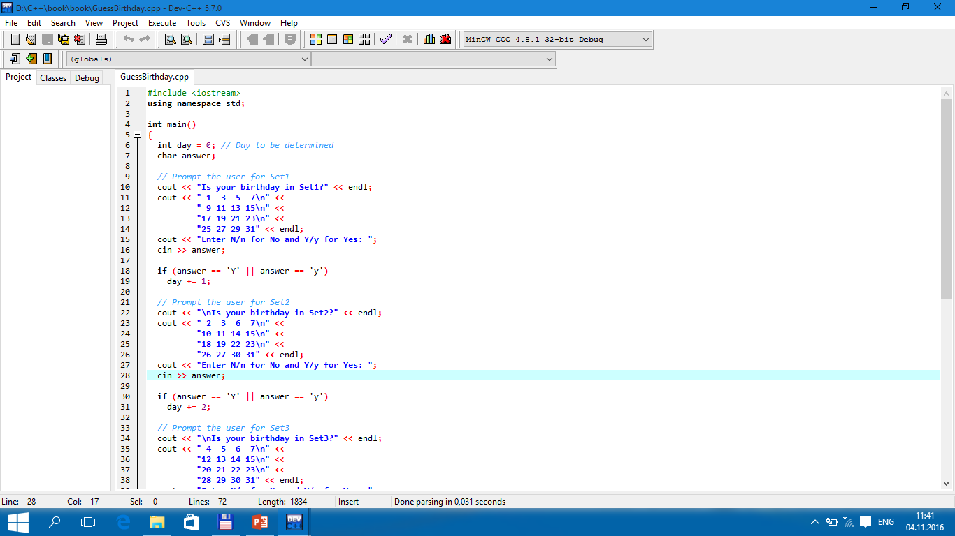
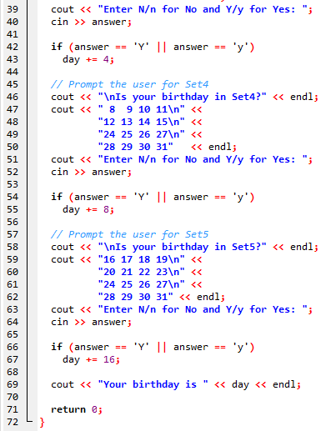
TUIT
Case Study: Guessing Birthday

Slide 36
TUIT
Case Study: Guessing Birthday
Is your birthday in Set1? 1 3 5 7 9 11 13 15 17 19 21 23 25 27 29 31 Enter N/n for No and Y/y for Yes: Y Is your birthday in Set2? 2 3 6 7 10 11 14 15 18 19 22 23 26 27 30 31 Enter N/n for No and Y/y for Yes: Y Is your birthday in Set3? 4 5 6 7 12 13 14 15 20 21 22 23 28 29 30 31 Enter N/n for No and Y/y for Yes: N Is your birthday in Set4? 8 9 10 11 12 13 14 15 24 25 26 27 28 29 30 31 Enter N/n for No and Y/y for Yes: N Is your birthday in Set5? 16 17 18 19 20 21 22 23 24 25 26 27 28 29 30 31 Enter N/n for No and Y/y for Yes: Y Your birthday is 19

Slide 37
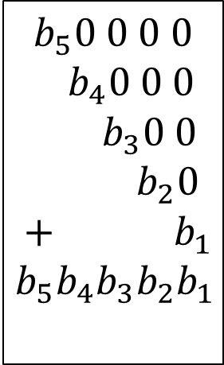
TUIT
Case Study: Guessing Birthday
This game is easy to program. You may wonder how the game was created.
Decimal | Binary
1 | 00001
2 | 00010
3 | 00011
… | …
19 | 10011
… | …
31 | 11111
$$b_{5}0 0 0 0$$
$${ b}_{4}0 0 0$$
$${ b}_{3}0 0$$
$$b_{2}0$$
$$+ b_{1}$$
$$b_{5}b_{4}b_{3}b_{2}b_{1}$$
10000
1000
100
10
+ 1
11111
31
10000
10
+ 1
10011
19

Slide 38
TUIT
Check Point
If you run GuessBirthday.cpp with input Y for Set1, Set3, and Set4 and N for Set2 and Set5, what will be the birthday?

Slide 39
TUIT
Summary
C++ provides the mathematical functions sin, cos, tan, asin, acos, atan, exp, log, log10, pow, sqrt, cell, floor, min, max, and abs for performing mathematical functions.
Character type (char) represents a single character.
The character \ is an escape character and an escape sequence starts with the escape character followed by another character or a combination of digits.
C++ allows you to use escape sequences to represent special characters such as ‘\t’ and ‘\n’.
The characters ‘ ‘, ‘\t’, ‘\f’, ‘\r’, and ‘\n’ are known as the whitespace characters.

